Slide 1
Prevention Science and Its Application to Evidence-Based Substance Use Prevention Interventions and Policies—The Role of Universities
Zili Sloboda, Sc.D., President
Maria Luna Jimenez, M.A., Director of Professional Development
Applied Prevention Science International, Inc.
International Consortium of Universities For Drug Demand Reduction
Cuzco, Peru
2019

Slide 2
How do you define “Prevention”?

Slide 3
Definition of Prevention
Prevention is the application of prevention science to address the health and safety of individuals through improving socialization processes to enhance self-realization and participation in society.
Source: UNODC, 2017

Slide 4
Outline of Presentation
1. Overview of Universal Prevention Curriculum Series (UPC) and the culture of prevention
2. UPC Training Goals and Learning Objectives
3. Critical Themes of UPC
4. Discussion of formats for translation to academia (on-line, face-to-face, both)
5. Discussion of assignment to develop a plan for integrating UPC content and material into current academic programs

Slide 5
Universal Prevention Curriculum and the Culture of Prevention

Slide 6
Member States of the Association of Southeast Asian Nations -November 2017
PROMOTE a culture of prevention for a peaceful, inclusive, resilient, healthy and harmonious society by focusing on:
understanding the root causes and consequences of violent extremism and other forms of violence and deviant behaviors at individual, organizational and institutional levels through risk assessment, research, forecast, early warning and other evidence-based methods;
adopting a mindset change from a reactive to a preventive approach;
inculcating shared values such as peace, harmony, intercultural understanding, the rule of law, good governance, respect, trust, tolerance, inclusiveness, moderation, social responsibility, and diversity;
developing effective upstream preventive policies and initiatives such as transformative social protection, public information, responsible use of media, as well as strengthening the existing values-based education in schools and institutions.

Slide 7
Why is having a Culture of Prevention Important?
Issue of readiness to
  introduce and
  sustain delivery of a prevention intervention
  …an evidence-based prevention intervention that has been developed based on prevention science

Slide 8
Culture of Prevention in Your Context

Slide 9
The Universal Prevention Curriculum is not only designed to build the capacity of those who deliver prevention interventions
BUT ALSO
To introduce a “Culture of Prevention” internationally!

Slide 10
Defining Prevention Science (1/2)
Prevention science is a multi-disciplinary field that examines both behaviors associated with positive and negative health outcomes
The primary goal of prevention science is to:
  improve public health by identifying malleable risk and protective factors,
  assessing the efficacy and effectiveness of preventive interventions and
  identifying optimal means for dissemination and diffusion.
Source: Standards of Knowledge for the Science of Prevention, Society for Prevention Research, 2011.

Slide 11
Defining Prevention Science (2/2)
The field involves the study of
  human development
  social ecology
  identification of factors and processes that lead to positive and negative health behaviors and outcomes
Prevention science is the foundation for health education and health promotion as well as preventive interventions.
Source: Standards of Knowledge for the Science of Prevention, Society for Prevention Research, 2011.

Slide 12
Prevention Science—Practice and Research
Practice
Research
Prevention Science

Slide 13
Major Components of Prevention Science
Epidemiology and Etiology
  defining the problem
  conducting research to understand predictors of problem and positive developmental outcomes (etiologic research)
  understanding the natural history of the problem
Intervention Development
  developing interventions to motivate changes in individuals and environment based on theories of human behavior and behavior change
  theory-based: etiology theories, learning theories, theories of behavior change
Research Methodology
  testing the efficacy of preventive interventions
  testing the effectiveness of these interventions in ‘real world’ delivery conditions

Slide 14
Availability of Components in Your Country
Epidemiologic databases?
Evaluation expertise?

Slide 15
Prevention Science: Why Is It Important to Prevention Professionals?
Prevention science provides the knowledge regarding:
  Who is affected by the behavior of interest and what are their characteristics (e.g., gender, age, geographic location)
  Who is vulnerable and what makes them vulnerable?
  What are the consequences of these behaviors over time?
  How do you intervene effectively with the individual or the environment to reduce the risk of initiation or continuation of these behaviors?

Slide 16
Prevention of Psychoactive Substance Use

Slide 17
Pharmacology and Prevention
Pharmacology tells us:
  how substances work in the brain
  where and how they produce their effects
  the negative consequences of their actions, and
  who is vulnerable to abuse and dependence
Understanding the pharmacology of psychoactive substances provides the basis for the development and implementation of effective prevention interventions and policies

Slide 18
Psychoactive Substances in Your Country
What are the psychoactive substances of concern in your country?
How do you think understanding the pharmacology of a substance provides the basis for the development and implementation of effective prevention interventions and policies?

Slide 19
Prevention Science and Substance Use:
Development of Effective Prevention Programs (1/3)
Epidemiology of substance use
  Establishment of the National Institute on Drug Abuse-1974
  National Household Survey on Drug Abuse: 1975
  Monitoring the Future Study: 1975
  Longitudinal Studies on Factors Associated with Initiation of Drug Use: 1975
Behavior Theory-1970s
First Effective Smoking Prevention Program: Late 1970s
Advances in Research and Statistical Methods: 1980s

Slide 20

Prevention Science and Substance Use:
Development of Effective Prevention Programs (2/3)
Reports of effective prevention programming (Pentz-1989; Bovin-1995)
1991 establishment of the U.S. Society for Prevention Research
First National Conference on Drug Abuse Prevention Research: Putting Research to Work for the Community: September 1996.
1997 publication by NIDA of Preventing Drug Use
Among Children and Adolescents: A Research-Based
Guide
2010 establishment of the EU Society for Prevention Research

Slide 21
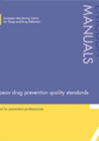
Prevention Science and Substance Use:
Development of Effective Prevention Programs (3/3)
2011 European Drug Prevention
Quality Standards
2013/17 International Standards on
Drug Prevention

Slide 22
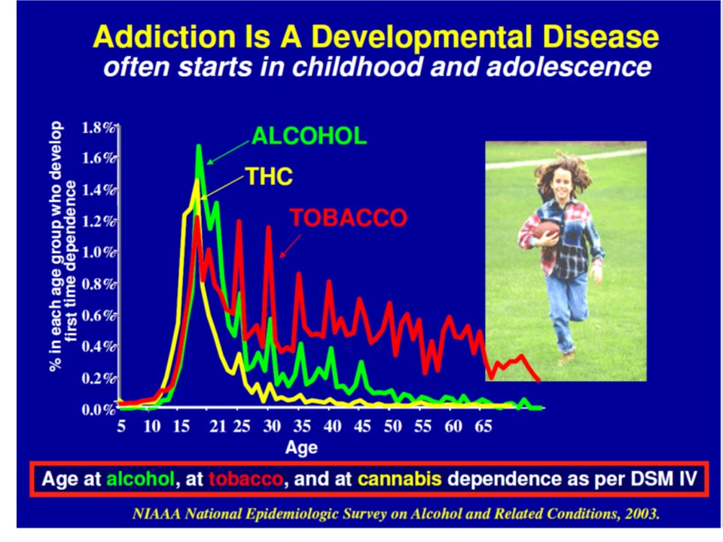

Slide 23
Substance Users Represent a Range of Use Patterns
In any population at any point in time we will find:
  Vulnerable non users
  Initial users who discontinue use
  Initial users with the potential to progress to abuse and substance use disorders
  Those who are already using and may or not be experiencing the consequences of their use.
Such a range in substance use patterns requires a range of interventions

Slide 24
Vulnerable Non-Users Not All Alike
Source: Crano et al, 2008

Slide 25
Does this framework apply in your country?

Slide 26
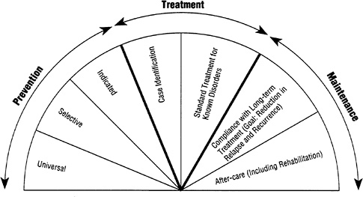
Spectrum of Substance Use Services
(Source: National Research Council, 1994)

Slide 27
Classification of Prevention Interventions
Universal---for those who represent a mixture of user groups, however most are non-users
Selective—for those who are vulnerable or determined to be at risk
Indicated---for those who may have already initiated substance use but do not need treatment

Slide 28
Why Doesn’t Everyone Who Tries a Substance Continue Use and Become Addicted?
Vulnerability to addiction differs from person to person
Abuse and addiction depends on both
  Biologic and environmental factors
Biological factors include genetics, which is estimated to account for between 40% to 60% of a person’s vulnerability to addiction.

Slide 31
Human Development and Vulnerability

Slide 32

Human Development Phases
Each stage of human development is associated with growth of intellectual and language development, cognitive, emotional and psychological functioning and social competency skills
Disruption of this growth can make the individual more vulnerable to problems such as substance use
Early intervention may prevent the onset
of substance use and dependence
Source: Campello, G. Etiological Factors in Substance use, UNODC, Prevention, Treatment and Rehabilitation. Presentation.
Notes:
32

Slide 33
Socialization – An Important Prevention Process
Human infants are born without any culture.
Socialization is a process of transferring culturally acceptable attitudes, norms, beliefs and behaviors and to respond to such cues in the appropriate manner.
Since socialization is a lifelong process, the individual will be socialized by a large array of different socializing agents (e.g., parents, teachers, peer groups, religious, economic and political organization and virtual agents, such as mass media).

Slide 34
Socialization Teaches Norms and Behavior
Socialization is the process for internalizing social norms and values that define or govern conduct and behavior particularly self-regulation through:
  Behavioral interventions
  Environmental interventions
34

Slide 35
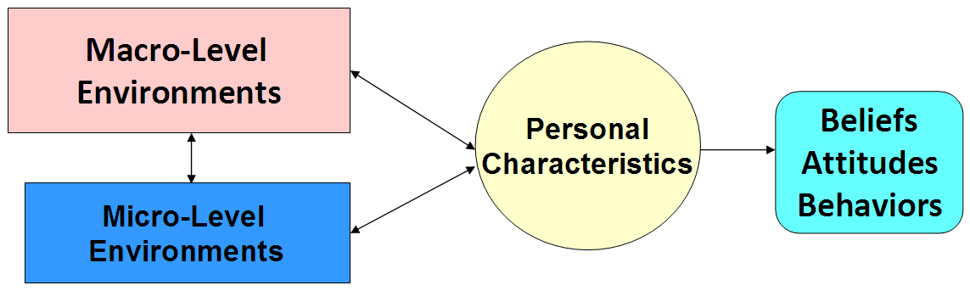
Etiology Model: Interaction of Personal Characteristics and the Micro- and Macro-Level Environments
Genetics
Temperament
Physiology
©UNODC 2013
35

Slide 36
Environmental Influences
Micro-Level Environmental Factors
  Family
  School
  Peer
  Workplace
Macro-Level Environmental Factors
  Social environment
  Physical environment
©UNODC 2017

Slide 37
Micro-Level Influence: Parents and Family
Parents and families:
  nurture children and keep them safe
  instill social and emotional regulatory skills
  teach children about sharing and reciprocity
  reinforce accepted norms, values, and age- and gender-specific behaviors of the community/society
Parenting and family continue to be important through adolescence when youth have more autonomy and opportunities for risky behaviors
©UNODC 2017

Slide 38
The Family continued
Key socialization agent for individuals becoming a part of the society into which they are born.
There are several dimensions or domains of the parent/caregiver-child that make the socialization process successful. Among these are the following:
  Forming an attachment to the caregiver and, thus, the family;
  Engaging in sharing or reciprocity relationships;
  Acquiring behavioral self-control; and
  Learning and internalizing accepted norms, values and age- and gender-specific behaviors of the community/society.

Slide 39
Schools: Why Do They Matter?
Schools are society’s most important agent of socialization outside the family. Schools:
Shape attitudes towards responsible behavior in general, and towards substance use in particular
Teach appropriate prosocial roles and behaviors and reinforce the positive behaviors that children learn at home and in the community
Provide children and youth an opportunity to practice these roles and behaviors under adult supervision

Slide 40
The Role of the Workplace (1/2)
The majority of adults are employed and participate in some type of work setting
Work and work settings drive the economy of communities and society and fuels economic growth
Work settings can provide additional training and education to workers
Work settings provide a venue for new experiences, new norms, and new behaviors

Slide 41
The Role of the Workplace (2/2)
Work provides benefits such as income and subsistence, social status and identity, stability, and a social network
The work setting or workplace can also present challenges and stressors
The transition from home or school to work entails new experiences, both positive and negative
How workers cope with these new experiences is key

Slide 42
Micro-level Influence: Peers
Peer relationships are influential socializing across the lifespan that affect
  attitudes,
  skills, and
  “normative” behaviors.
©UNODC 2017
Notes:
42

Slide 43
Macro-Level Influences of the Social and Cultural Environment
The social environment of the larger community influences beliefs, attitudes and behaviors through:
  Shaping social norms
  Influencing beliefs about the risks and consequences of using psychoactive substances
  Effecting stress responses
  Enforcing patterns of social control
©UNODC 2017

Slide 44
Macro-Level Influences of the Physical Environment
Uninhabited buildings
No working street lights
Infested habitats

Slide 45
Think/Pair/Share: Socialization and Substance Use Prevention Policy
With the person next to you:
Discuss and share examples of prevention interventions/policies in your country at the micro and macro levels
How do you think the socialization concept just presented could contribute in shaping substance use policy in your countries?

Slide 46
Etiologic Studies
Determinants of or factors involved in substance use initiation
  Longitudinal studies of children and adolescents
    General populations
    Children of substance users

Slide 47
Risk and Protective Factors: Background (1/2)
In the mid-1970s, several longitudinal studies were conducted that followed cohorts of early adolescents into adulthood that examined factors that were related to substance use initiation
In 1992 two significant works summarized this research on factors related not only to the initiation of substance use but also to the progression from use to abuse
Hawkins, J. D., Catalano, R. F., & Miller, J. Y. (1992).
Glantz, M. D. & Pickens, R. W. (1992).

Slide 48
Risk and Protective Factors: Background (2/2)
Risk factors are defined as measures of behavior or psychosocial functioning (including attitudes, beliefs, and personality) that were found to be associated with increased risk to use psychoactive substances
  Contextual factors
  Individual and interpersonal
Protective factors involve measures that appear to prevent the use of psychoactive substances or reduce the untoward negative effects of risk. Protective factors identified through research include strong bonding to family, school, community and peers that hold prosocial attitudes and support prosocial behaviors.

Slide 49
Large Group Exercise: Brainstorming Risk and Protective Factors
What are some of the most common risk and protective factors that your countries try to address through prevention interventions and policies?

Slide 50
Vulnerability Goes Deeper than Risk and Protective Factors to Causation

Slide 51
Vulnerability and Development (1/2)
Each stage of development, from infancy to early adulthood, is associated with the growth of the following as an person matures:
  Intellectual ability
  Language development
  Cognitive, emotional, and psychological functioning
  Social competency skills
Any major disruption of this growth will make a person more vulnerable to problem behaviors such as substance use
©UNODC 2013

Slide 52
Vulnerability and Development (2/2)
Prevention needs to intervene early in each developmental phase to prevent the onset of substance use and dependence

Slide 53
Etiology Model
Social and Cultural
Economic/Poverty
Physical
Genetics
Temperament
Physiology
Family
Peers
School
Faith-Based Organizations
Workplace
©UNODC 2013

Slide 54
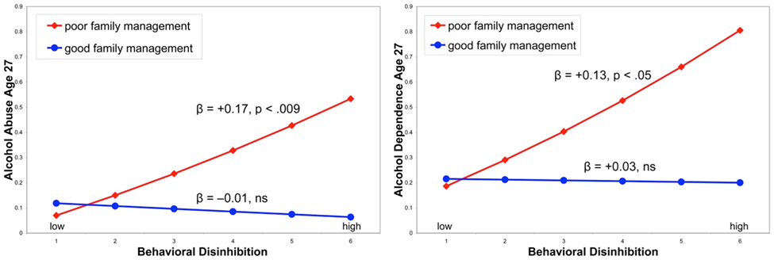
Interaction between Personal Characteristics (Vulnerability) and Micro-Environment
Figure 1.
Interactions between behavioral disinhibition and family management in adolescence
predicting alcohol abuse (left panel) and dependence (right panel) criteria at age 27.
Source: Hill et al., 2010.

Slide 55
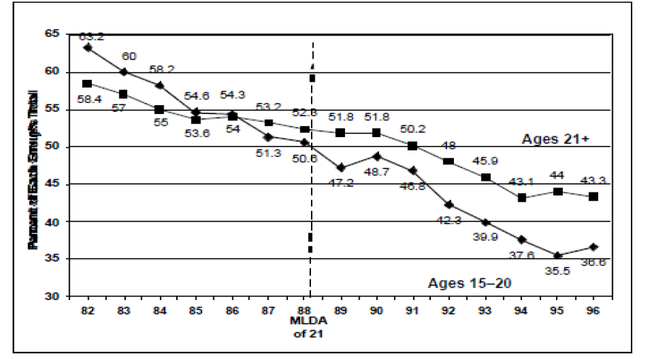
Macro-Environment Influence: Increasing the Minimum Legal Drinking Age: Alcohol-Related Motor Vehicle Fatalities
55

Slide 56
Prevention is a Socialization Agent

Slide 57

Behavioral Interventions - Prevention Professionals (1/2)
May either train socialization agents, such as parents and teachers to help them:
    Improve their socialization skills (parenting, classroom management)

Slide 58

Behavioral Interventions - Prevention Professionals (2/2)
Or directly engage in the socialization process, thus becoming socialization agents themselves to help individuals:
    Understand what is expected of them in different social and emotional contexts
    To “try on” new behaviors
    To weigh the potential outcomes for these behaviors within their own social
    and emotional context.

Slide 59
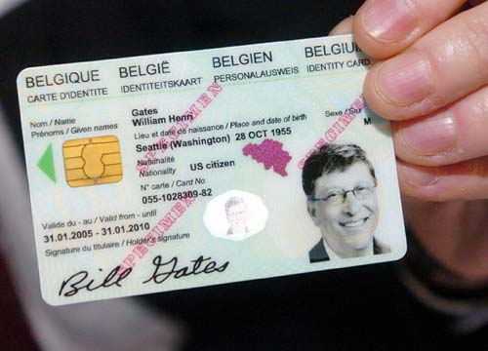
Environmental Interventions (EIs) - Prevention Professionals
Create healthy environments that maximize the strengths of the community and minimize negative influences that might exist.
Deliver EI’s to change the context in which people make decisions about behaviors
  Physical environment—Limiting access to
  and availability of alcohol, tobacco and
  other substances
  Social environment—Reinforcing non-use norms and attitudes
59

Slide 60
Environments for Prevention Based on the Etiology Model

Slide 61
Points of Intervention
Macro-Level
Environments
Beliefs
Attitudes
Biological/
Personal
Characteristics
Behavior
Intent
Social and Cognitive Competence
Skills
Micro-Level
Environments
= Points of Intervention
Socialization
©Sloboda, 2014

Slide 62
Substance Use Evidence Based Interventions and Policies

Slide 63
International Standards on
Drug Use Prevention
©UNODC 2017
Notes:
63

Slide 64
Intent of the International Standards
To summarize the currently available scientific evidence, describing effective interventions and policies and their characteristics.
To identify the major components and features of an effective national substance use prevention system.
Ultimately, to help policy makers worldwide to support programs, policies and systems that are a truly effective investment in the future of children, youth, families and communities.
©UNODC 2013
Notes:
64

Slide 65
What Do We Mean by “Evidence-based”?
“Evidence Based Practice (EBP) is the use of systematic decision-making processes or provision of services which have been shown, through available scientific evidence, to consistently improve measurable client outcomes. Instead of tradition, gut reaction or single observations as the basis of decision making, EBP relies on data collected through experimental research and accounts for individual client characteristics and clinician expertise.”
(Evidence Based Practice Institute, 2012; http://depts.washington.edu/ebpi/)
©UNODC 2017
Notes:
65

Slide 66
International Standards:
Categorization of Interventions and Policies
Developmental framework
  Infancy and early childhood
  Middle childhood
  Early adolescence
  Adolescence and adulthood
Setting
  Family
  School
  Workplace
  Community
Target population
  Universal
  Selective
  Indicated
©UNODC 2017

Slide 67
What Is Included in the Standards?
For each intervention and policy:
  Short description and rationale for the intervention or policy
  Summary of the evidence
  List of the characteristics that have been found to be linked to positive outcomes, as well as to NO or NEGATIVE outcomes.
  Additional existing guidelines/ tools/ resources.
Chapter on the critical components of a national drug control system
©UNODC 2017

Slide 68
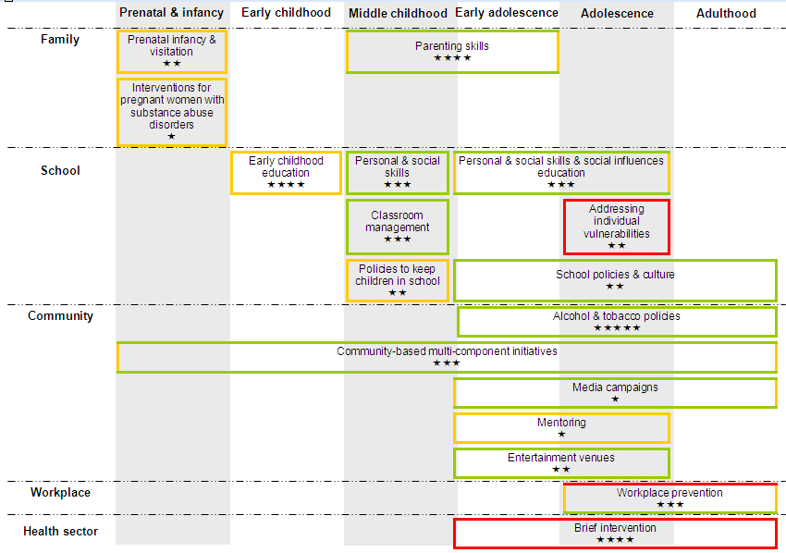
Summary Including an Indication of Efficacy
©UNODC 2013

Slide 69
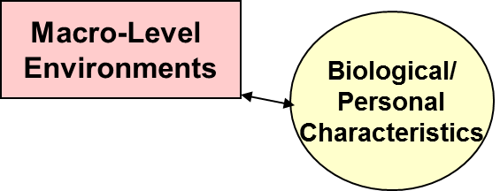
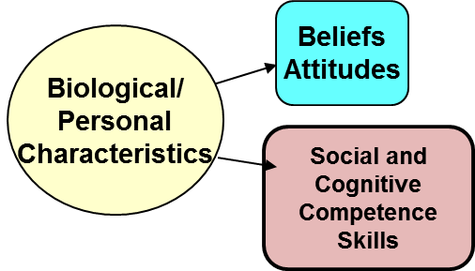
Intervention Points-Examples of Evidence-Based Prevention Strategies
Interaction1
Interaction 2
Interaction 3
Biological/
Personal
Characteristics
Micro-Level
Environments
Family
Parenting Skills
Management
School
Substance Use Policy
School/Classroom Climate
Substance Use Curriculum
Workplace
Substance Use Policy
Workplace climate
Wellness education
Laws, Regulations, Policies
Access to alcohol and tobacco
Retail strategies
Media
Targeting messages effectively
Use of credible messengers
Adequate exposure
Addressing individual psychological vulnerabilities
Coping strategies

Slide 70
PREVENTION PROFESSIONALS

Slide 71
Who are the prevention professionals in your country? What are they doing? What is their training?

Slide 72
Trained Prevention Professionals
    Knowledge
    Competencies
    Skills
    Integrity
    Ethics

Slide 73
Examples of Knowledge Elements
The concept of vulnerability and the influence of micro- and macro-level environments on risk and protection
Existing recognized evidence-based prevention interventions
Specific programs that exist for schools, family, workplace
Parenting courses and education/prevention interventions that are available for children and families
Evidence-based principles of substance use prevention
Knowing how to fit evidence-based prevention into existing schedules and organizations, particularly schools
Understanding the organizational barriers and facilitators for institutionalizing evidence-based prevention interventions in schools, social and health services agencies, the workplace and community
The different developmental needs and vulnerabilities of boys and girls during adolescence.
What institutions exist at local, regional and national level and what type of services do they provide to communities (to build partnerships).
Referral places where particularly vulnerable youth could be referred
Prevention delivery systems: is able to describe implementation systems and their components and importance, and knows how to improve them
Reporting laws for child abuse, intimate partner violence and how to file reports
The importance of fidelity of implementation

Slide 74
Skills
Able to implement Universal Interventions effectively
Familiar with the main forms and signs of problem behavior or signs of physical abuse: able to notice events in a group and disruptive behavior (exceeding social standards) of individual youth and know where or to whom to refer them.
Able to identify signs of substance use symptoms, in order to refer them to higher trained professionals
Able to demonstrate culture-and gender‐appropriate respect through own behaviors, including appropriate eye contact, language, tone of voice, and attention.
Capacity to lead interactive instructional strategies
Ability to systematically collect, organize and report monitoring information, including feedback from participants of the intervention
Capacity to communicate with other implementers and to address them properly
Capacity to work effectively with gender, specifically with youth who are still developing their identities and who are in the process of discovering and articulating their orientation/identity, interests, and goals

Slide 75
ATTITUDES AND ATTRIBUTES (1/2)
SERVICE SPECIFIC ATTITUDES
Hold no moral or judgmental attitudes about the opinions and behaviors expressed by the target population(s).
Respect youth and related behaviors, including experimenting with substances
Recognize youthful behavior as normal and to be expected
Value and express compassion, warmth, support, empathy, authenticity, humility, and sensitivity
Agree with need for quality in prevention, is motivated to improve quality in prevention and to apply standards
Have positive views of evidence-based prevention interventions and policies
Have positive views towards manualized programs
Have positive attitudes towards monitoring and monitoring tools (process evaluation)
Understands and applies prevention ethics appropriately

Slide 76
ATTITUDES AND ATTRIBUTES (2/2)
SELF-AWARENESS AND PROFESSIONAL DEVELOPMENT
⃝ Have available time and dedication for prevention activities
⃝ Appreciate that parenting goes beyond a set of skills and includes the relationship and connection between caregivers (parents or grandparents, older siblings, relatives and the child).
⃝ Believe that family and school are assets to prevention
⃝ Live experience, high emotional intelligence
⃝ Be motivated to be a positive role model and have a positive impact on youth
⃝ Readiness to not employ obsolete methods and to distance oneself from one’s own beliefs or instincts if in conflict with others
⃝ Readiness to openly collect opinions, feedback and criticism from the target group or others concerned about the intervention and its adequacy.

Slide 77
Putting it Together: Implementation Cycle-The Basic Components
Needs and Resource Assessments
Selection of Evidence-Based Interventions and/or Policies
Preparation and Implementation of the Intervention/
Policy
Dissemination and Improvement
Monitoring and Evaluation
Outcomes:
Short, Intermediate and Long Term

Slide 78
Professional Ethics in Prevention
  Models to guide behavior and decision-making in prevention
    The White and Popovits Model
    Prevention Think Tank Model

Slide 79
Professional Ethical Judgment
Even with an ethical code, there are instances of ambiguity. Therefore professional judgment is important to guide decisions. One needs:
Active knowledge of national, regional, and local regulations and laws
An established deliberative process

Slide 80
Ethical Decision Making Process
Source: http://run2life.org/resources/resources/Ethical-Decision-Making-Process-Summary.pdf

Slide 81
The Universal Prevention Curriculum (UPC)

Slide 82
Adapting Science to Practice: Learning EB Prevention
Knowledge
Pharmacology of Substances and the Brain
Skills
UPC
Prevention Science Principles, Theories
Competencies
Integrity
Literature, EB Prevention Interventions & Policies and Implementation
Code of Ethics

Slide 83
Purposes of Universal Prevention Curriculum (UPC)
Meet the current demand for an evidence-based curriculum for substance use prevention professionals-researchers, practitioners, policy makers
Provide a curriculum for those professionals who may not ‘label’ themselves substance use prevention professionals but who are providing substance use prevention services
Ensure that regionally- and nationally-based prevention professionals obtain consistent science-based-information and skills training
Building an international prevention capacity through training, professionalizing, and expanding the substance use prevention workforce

Slide 84
UPC Series for the Coordinator and Implementer
There are two UPC Series:
UPC Coordinator Series is designed for prevention coordinators and decision-makers
UPC Implementer Series is designed for prevention professionals who provide/deliver the evidence-based prevention interventions and policies

Slide 85
Key Elements of the UPC-Series
Introduction to prevention science and application to prevention interventions
Physiology and pharmacology of psychoactive substance use
Uniform definition of prevention—UNODC
Evidence-based prevention and the International Standards on Drug Use Prevention
Prevention science as the foundation for UPC
Critical themes (review in later slide)
Implementation Cycle (adapted from EMCDDA EDQSP)

Slide 86
Focus: Prevention Science
Publication of the International Standards on Drug Use Prevention* focuses on the latest research in prevention science and principles and elements of evidence-based prevention interventions and policies;
The need to update knowledge of prevention professionals about these evidence-based findings; and,
The encouragement of government officials, policy makers, and other stakeholders to apply prevention science to the practice of prevention throughout the world.
* United Nations Office of Drugs and Crime (UNODC), 2013; 2015.

Slide 87
UPC Coordinator Series Courses-
Knowledge-Focused
Introduction to Prevention Science (5 days)
Physiology and Pharmacology for Prevention Specialists (3 days)
Monitoring and Evaluation (5 days)
Family-Based Prevention Interventions (4 days)
School-Based Prevention Intervention (6 days)
Workplace-Based Prevention Intervention (4 days)
Environmental Prevention Interventions (3 days)
Media-Based Prevention Interventions (3 days)
Community-Based Implementation Systems (5 days)

Slide 88
UPC Implementer Series Tracks-Translate Application of Knowledge to Implementation
Core-Introduction to UPC-Implementer Series
Monitoring and Evaluation (with Practica)
Family-Based Prevention Interventions (with Practica)
School-Based Prevention Intervention (with Practica)
Workplace-Based Prevention Intervention (with Practica)
Environmental Prevention Interventions (with Practica)
Media-Based Prevention Interventions (with Practica)
Community-Based Prevention Implementation Systems (with Practica)

Slide 89
UPC Helps Prevention Professionals to:
Speak with one voice about evidence-based prevention interventions and policies
Support comprehensive, integrated evidence-based prevention and policies that are APPROPRIATE for their communities, and,
Plan, implement, monitor, and sustain these evidence-based prevention interventions and policies

Slide 90
Role of the University
Train new prevention professionals
Train professionals from other fields to become prevention professionals
Build the capacity of prevention professionals in the field with up-to-date information to improve the delivery of evidence-based professionals
Recognize and advocate for prevention science and the professionalization of the prevention workforce
Work towards establishing the comprehensive, integrated continuum of evidence-based substance use interventions

Slide 91
Examples of UPC Integrated into University Programs
Kent State University College of Public Health-Masters of Public Health Elective on Community-Based Prevention
Charles University—Bachelors, Masters, and Doctoral Program on Addictionology (integrating treatment and prevention)

Slide 92


Kent State University College of Public Health

Slide 93
Three-Pronged Training (1/2)
Graduate program in the College of Public Health
  the UPC Coordinators series, beginning with the first two courses (Intro to Prevention and Pharmacology) in the Spring/Summer of 2018
  the second course offering will be Community-Based Prevention Implementation Systems curriculum (Spring/Summer 2019)
  the courses will initially be offered as electives open to all MPH students

Slide 94
Three-Pronged Training (2/2)
Prevention Professionals
  Partnering with APSI and the Bureau of Prevention of the Ohio Department of Mental Health and Addiction Services offered seminars targeting Ohio prevention professionals during in the Fall 2018; over 50 prevention professionals and graduate students attended these one-week sessions.

Slide 95

Universal Prevention Curricula:
Charles University

Slide 96
Universal Prevention Curricula:
Content Analysis of UPC and existing program
Comparative Study
Inserting UPC Curricula into the existing program

Slide 97
For Bachelors degree program focus was on the Implementer Series (practical oriented professional in the field).
For Masters program we put emphasis on the Coordinator Series.
The major shift was represented by a more universal profile and more general definition of competencies: from the original focus that was just on school-based prevention (Prague model) we made the profile more general - according to the content and focus of all UPC tracks.

Slide 98
Learning outcomes (knowledge-skills-competencies) play a critical role in the European accreditation rules for universities (Bologna process) UPC served to redefine learning outcomes for both levels/programs according to the new profile of competencies
The UPC trainer manuals play a critical role – all key concepts, terminology, definitions etc. – are available and helpful – “not necessary to create anything from grass level”.
The trainer manuals give perfect backup for this work and provide perfect and fully transferable “packages” that needed just small adaptations (European examples, local programs, small terminology changes etc.)

Slide 99
University-based Curricula for Prevention Professionals
Opportunities to offer:
  Providing UPC-derived online or in-class training on special focused areas, such as prevention related to the family, the school, the workplace, the media, and the community with environmental interventions and policies;
  Adding or adapting UPC-related specialty tracks on skills plus practica in training for teachers, counselors, and related substance use prevention and treatment fields;
  Bringing UPC on board for courses related to public health and behavioral health prevention programming.
  ????? What are your thoughts?????

Slide 100
Other approaches

Slide 101
APSI – UPC TRAINING CENTER
On – Line: Knowledge-based
  Coordinators
  Supervisors
  Decision makers
Blended (Knowledge and skills-based)
  Implementers
“Nuggets” (Knowledge and/or skills-based)
  All prevention professionals

Slide 102
On-Line – Knowledge based
Requirements | Virtual / On-Line
No. of Participants | Unlimited
No. of Trainers/Facilitators | 1 facilitator for every 20 students
Time/Schedule | 6 – 8 weeks
Assessment | Pre/post test, quizzes, group work and final essay.
Host | APSI Training Center
Logistics | -
Materials | Self-provided computer and other print-outs
Training hours | 24 – 30 depending on course
Face-to-Face | Optional (adds 24 training hours)

Slide 103
Blended – Knowledge and Skills Based
Reqs. Method | On-Line | Classroom based (F2F)
No. of Participants | Unlimited | Unlimited
No. of Trainers/Facilitators | 1 facilitator for every 20 students | 1 trainer up to 24 participants, one trainer is required. Above 20 and up to 25, two trainers are required in one room. Above 25 participants, the group splits into 2 rooms with one trainer each room. All trainings can occur simultaneously, but not a requirement.
Time/Schedule | 6 – 8 weeks | 3 days.
Assessment | Knowledge-based Pre/post test, quizzes, group work and final essay. | Skills-based Practica
Host | APSI Training Center | Varies
Logistics | - | - Trainers and participants mobility/travel - Training. Room with all the necessary audiovisual equipment Coffee Breaks and lunches
Materials | Self-provided computer and other print-outs | Participant Manual Flipcharts, markers, nametags, paper, post its, etc..
Training hours | 24 – 30 depending on course | 24 hrs

Slide 104
“Nuggets” for prevention professionals
What is a “nugget”?
Specialized workshops tailored to specific knowledge or skills needed by prevention professionals in different areas.
Fundamental and focused topics from prevention science and prevention intervention settings.

Slide 105
Examples of “nuggets”
Setting | Topic | Methodology | Learning hours
Introduction to Prevention Science | Critical themes for applying prevention science to practice | On – Line | 3
School | Developing school-based prevention policies | Classroom-based | 8 hours
Family | Barriers and challenges to family interventions - Challenges - Recruitment, Engagement and Retention - Fidelity and Adaptation | On – Line | 3 hours
Workplace | Developing workplace based prevention policies | Classroom-based | 8 hours
Media | Understanding Media and its use in Prevention | On – Line | 3 hrs
Environmental | Environment-based prevention interventions and policies: what are they? | On – Line | 3 hrs
Community | What is a community-based prevention implementation system? | On – Line | 3 hrs
Monitoring and Evaluation | Building monitoring systems | Classroom based | 3 hrs

